Slide 1
CASE STUDY 2
Catalog Cross Selling

Slide 2
Content
Business Need
Objective
EDA
Association Rules
Conclusion

Slide 3
Business Need
Exter Inc. sells products in different number of catalog, and wants to cross promote the product effectively to increase the sale of other.

Slide 4
Objective
Perform an association rule analysis and identify which product can go in pair to certain segment of customer.

Slide 5
Exploratory Data analysis

Slide 6
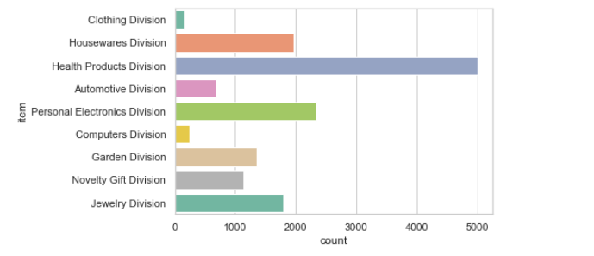
CATALOG SALES COUNTS
Note: Health products division is in all rows, so we can remove this column and perform the association rule analysis

Slide 7
Association with min support 0.01

Slide 8
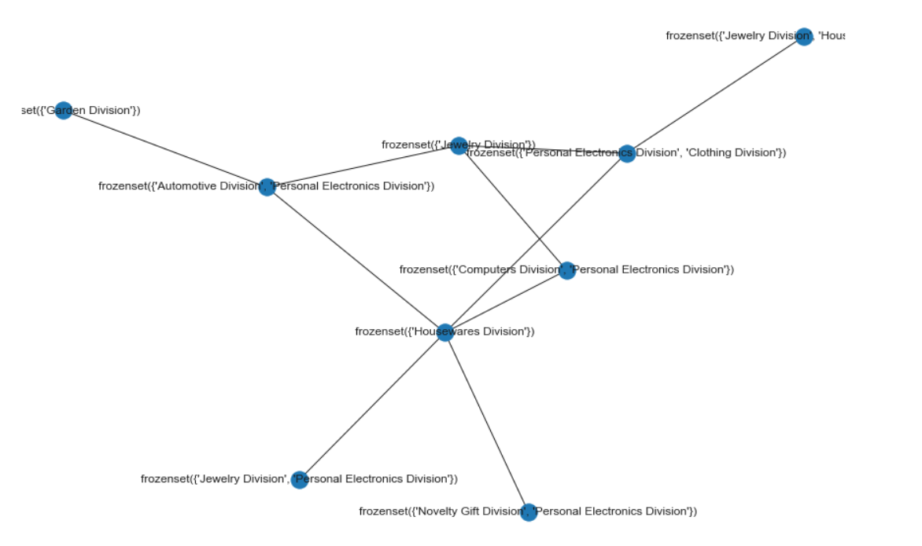
From above graph, we can clearly see that Personal Electronics Division along with automotive, and computer division corresponds to Jewelry Division, or Housewares Division

Slide 9
From above graph, we can clearly see that Personal Electronics Division along with automotive, and computer division corresponds to Jewelry Division, or Housewares Division

Slide 10
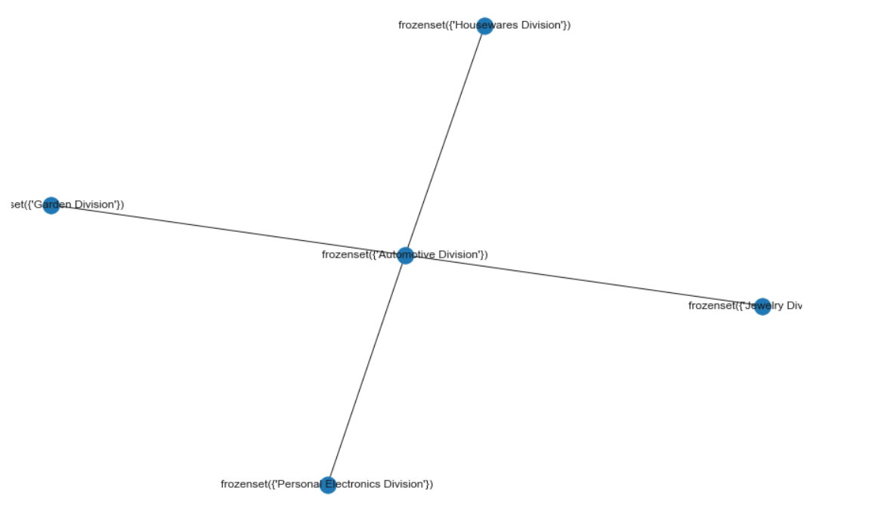
Automotive Division is one which corresponds to other divisions, so a better option is to place Garden division catalog with 60% confidence and lift of 2.32, so it's more likely to catch the customer when automotive division product is being sold

Slide 11
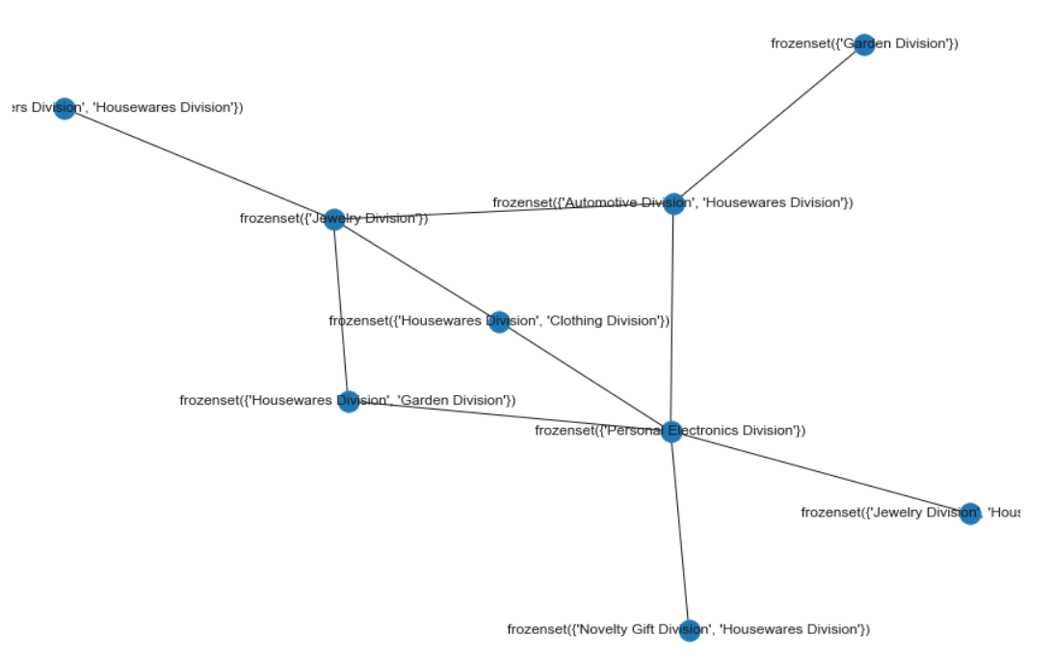
Houseware Division, with other division corresponds to Personal Electronics Division, so placing Personal Electronics Division catalog in Houseware division item shipment will results in more sales of PED items.
Same way, jewelry division sales can also be increased if placed in Houseware Division shipment

Slide 12
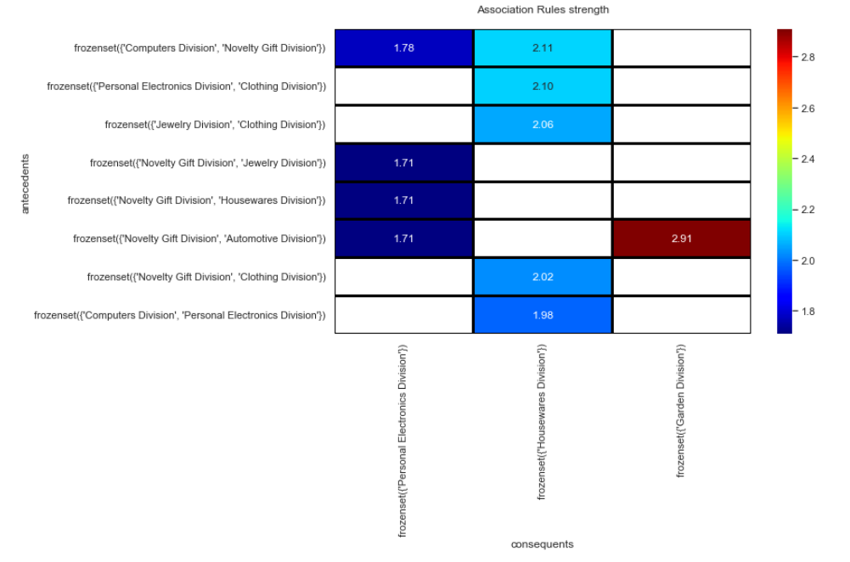
RULE STRENGTH
Rules strength are the key to increase the sales of catalog. We can use popularity of one item to increase sales of other items.
Here Personal Electronics Division catalog can be send with Novelty Gift, Computers, Jewelry and Housewares Divisions.
Same way garden division can be send with Automotive division and Novelty Gift Division shipments/email with a lift of 2.91

Slide 13
Association with min support 0.05

Slide 14
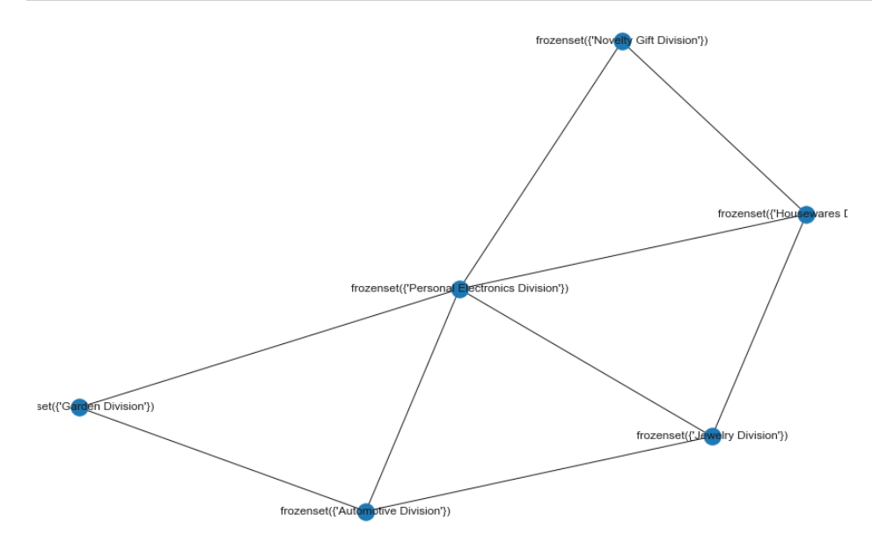
This graph perfectly explains of the catalog should go with which type of shipment, with a decent lift and confidence above 50% for all

Slide 15
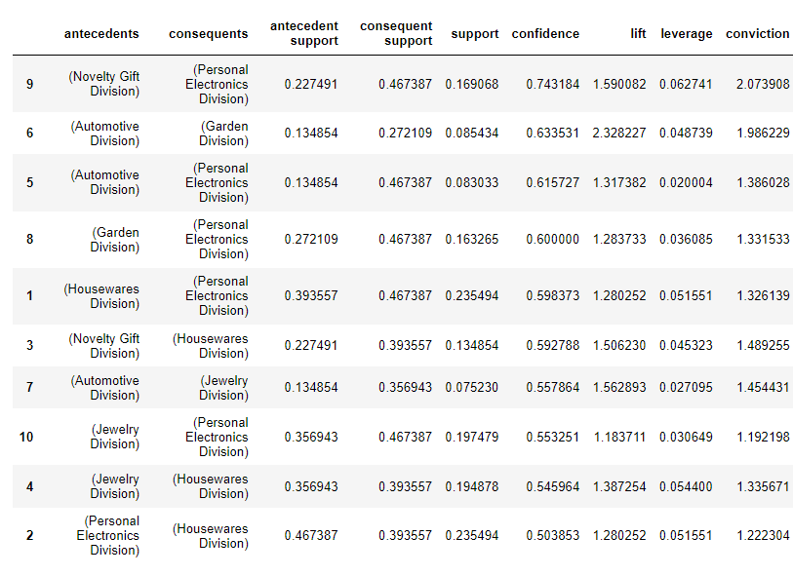

Slide 16
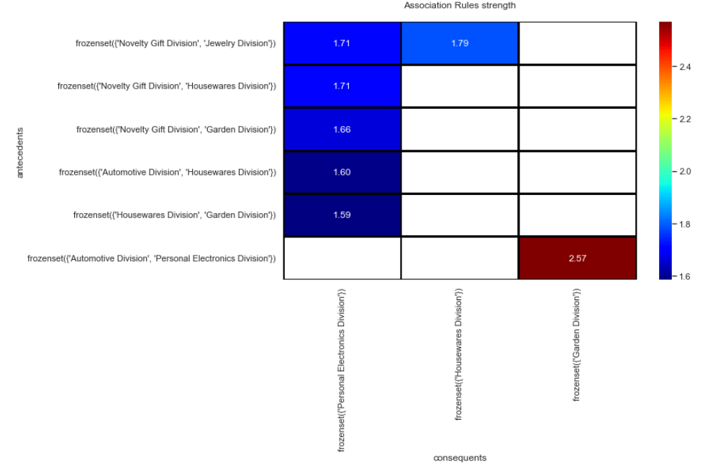
RULE STRENGTH
This shows the Garden division catalog can be send with Personal Division and Automotive division shipments,with a lift of 2.57 for a sell being made.
Houseware division can go with Jewelry Division and Novelty Gift Division.

Slide 17
Conclusion
We derived few rules using different support level (popularity of rule).
One shortcoming of such analysis is that large set results very large number of rules which may be complex. We found the strong rule among the set to give our rules.

